Slide 1
N
N

Slide 2
N
This or scroll of my code
N

Slide 3
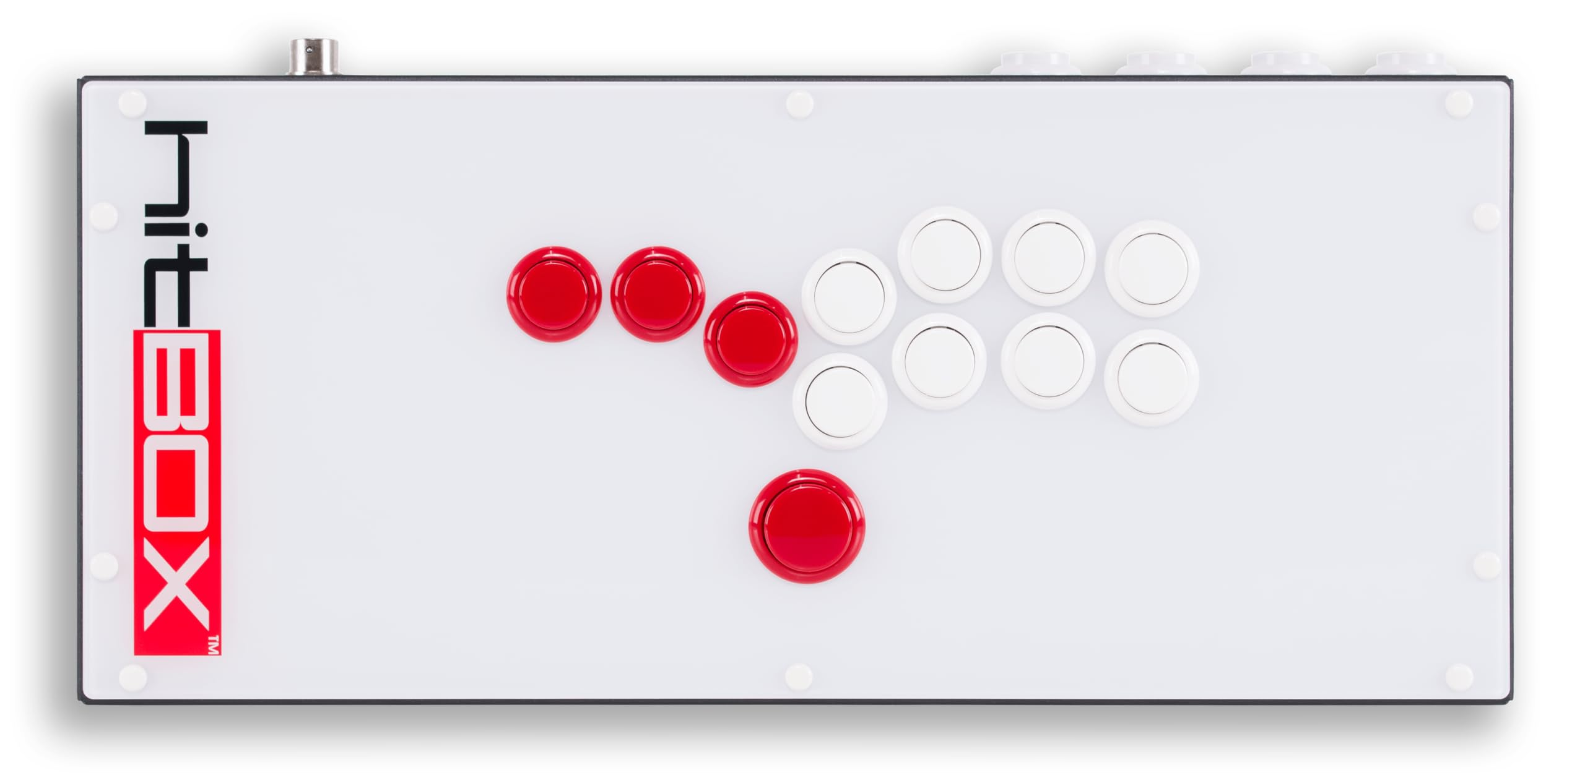

Slide 4


Slide 5


